Slide 1
Data Programming in R Group Project
Group <- c (“Kristine Arens”
, “Cody Burger”
, “Michelle Cutlip”
, “Ben Huntington”
, “Matthew Pelham”)
Notes:
Michelle - introductions

Slide 2
Project overview
The Situation <- Which factors contribute to a post-secondary school’s
student loan default rates?
Influence of cost of attendance on default rate
Correlations between school type and default rate
What geographic areas have the highest and lowest default rates
Use of the Data <- U.S. Department of Education's Plan and Policy Development Guidance for Public Access
Notes:
Michelle
Situation:
Analyze data from post-secondary institutions which means programs eligible for Federal Funding. This included schools such as vocational/technical training up through a public or private college institutions. Non-degree (0-3 years), associates, masters, PhD.
Data:
Initial dataset was from US Department of Education Federal Student Aid (default data)
Data was organized by school, each with an OPEID
Peps300 dataset
# students in default, rate type, ethnic affiliation of school, school location
To strengthen data, located other data about schools on National Center for Education Statistics
Various datasets organized by school
Chose 3 datasets – each with many variables but interested in only
Attendance
Latitude and longitude
Cost

Slide 3
Data sources
<- Department of Education Federal Student Aid (Peps300)
School default rate
School type
Program length
School ethnic affiliation
Number of students in default
Number of students in repayment
<- National Center for Education Statistics (IPEDS)
School longitude and latitude coordinates
School attendance numbers
School tuition and fees
OPEID and Unit ID
Notes:
Michelle
Initial dataset was from US Department of Education Federal Student Aid (School cohort default rate data file)
Data was organized by school, each with an OPEID (Office of Postsecondary Education Identifier)
Program length: The length of the longest program offered by the institution. Includes from non-degree programs up through institutions offering PhD degrees
0—Short-Term (300–599 hours) 1—Graduate/Professional (≥ 300 hours) 2—Non-Degree (600–899 hours)
3—Non-Degree 1 Year (900–1799 hours) 4—Non-Degree 2 Years (1800–2699 hours) 5—Associate's Degree
6—Bachelor's Degree 7—First Professional Degree 8—Master's Degree or Doctor's Degree
9—Professional Certification 10—Undergraduate (Previous Degree Required) 11—Non-Degree 3 Plus Years (≥ 2700 hours)
12—Two-Year Transfer
Ethnic Code The code classifying the ethnic affiliation of the institution:
1—Native American 2—HBCU (historically black college/university) 3—Hispanic 4—Traditionally Black College 5—Ethnicity Not Reported
To strengthen data, located other data about schools on National Center for Education Statistics – Integrated Postsecondary Education Data System
The Integrated Postsecondary Education Data System (IPEDS) is a system of interrelated surveys conducted annually by the U.S. Department of Education's National Center for Education Statistics (NCES). IPEDS annually gathers information from more than 7,500 colleges, universities, and technical and vocational institutions that participate in the federal student aid programs.
Various datasets organized by school
Chose 3 datasets – each with many variables but interested in only (IC – 145 (cost), HC- 66 (long/lat), EFFY – 34 (attendance)
Attendance
Latitude and longitude
Cost
Downloaded datasets (3 years x 3 datasets)
Combined into one Excel spreadsheet pulling in only columns of interest
Each subset and year was put on it’s own sheet in IPEDS full dataset

Slide 4
initial Project challenges
<- Locating school data
<- Finding table to sync OPEID and UNITID
<- Streamlining correspondence and splitting the work breakdown
Notes:
Michelle
Locating school data
2 group members work in postsecondary education, 3 work for insurance companies
Decided to research postsecondary education data from the group members schools, but that wasn’t possible.
Internet searches to find data of interest.
OPEID and UNITID
Department of Education Federal Student Aid data indexed by UNITID
IPEDS data – most indexed by OPEID
Search to find a data table with both values to use to join the data – found on IPEDS site
The numbers needed manipulation by removing leading 0’s in one table, adding 0’s in another in order to match
Correspondence
How to communicate – started with a “group” in ICON, but found that follow-up discussions weren’t alerting members to new message.
Also, no way to track file versions.
Switched to group email and to GitHub for file sharing
Challenge in deciding how to split up the work. Split up into: 3 people each take a sub-topic to study, code, graph
One person concentrate on importing and meshing the data, and writing the function.
One person worked on IPEDS dataset, renamed columns, organized paper and powerpoint..

Slide 5
Importing and combining the data
<- 3 Data Sources:
Department of Education (Default Rates) – Data from 2012-2014, OPE ID as Identifier
National Center for Education (School Info) – Data from 2011-2013, Unit ID as Identifier
Mapping file – Linking Unit IDs to OPE IDs to tie default rates to school information
<- Data in Excel Workbooks with Multiple Sheets for NCE Data
Creating multiple csv files was time consuming and cumbersome
Solution – openxlsx package
read.xlsx("IPEDS full dataset.xlsx", sheet = 2, na.strings=c("", "."))
Notes:
Matt
Discuss function to pull in data and join the dataframes
Each of the 3 types of analyses code were created, and wrapped into separate functions
Challenges in setting this up

Slide 6
Importing and combining the data
<- Combining NCE Data School Info with Default Rates (Mapping Data)
<- Default Rates (OPE ID) - (OPE ID) Mapping (Unit ID) - (Unit ID) NCE Data
Reformat Default Rates Data OPE ID:
peps300$OPEID <- as.integer(peps300$OPEID) #Remove Leading 0’s
peps300$OPEID <- as.character(peps300$OPEID)
peps300$OPEID <- paste0(peps300$OPEID,"00") #Add trailing 0’s
Join Default Rates With Mapping: merge(codes,peps300,by.x = "OPE.ID",
by.y = "OPEID")
Join Mapping With NCE Data: merge(full_df, ic2012, by.x = "Unit.ID",
by.y = "UNITID")
8 total joins to combine all NCE Data
Notes:
Matt
Discuss function to pull in data and join the dataframes
Each of the 3 types of analyses code were created, and wrapped into separate functions
Challenges in setting this up

Slide 7
Cleaning the data
<- “Unflattening” The Data
ID | Name | DefaultRate2012 | DefaultRate2013
12345 | U of Iowa | 15.6 | 20.2
Year | ID | Name | DefaultRate
2012 | 12345 | U of Iowa | 15.6
2013 | 12345 | U of Iowa | 2013
<- Other cleanup:
Sub setting data sets to common years of 2012 and 2013
Factors for School Type and Program Length
Meaningful column names
Removal of duplicate OPE ID – Unit ID combinations
Notes:
Matt

Slide 8
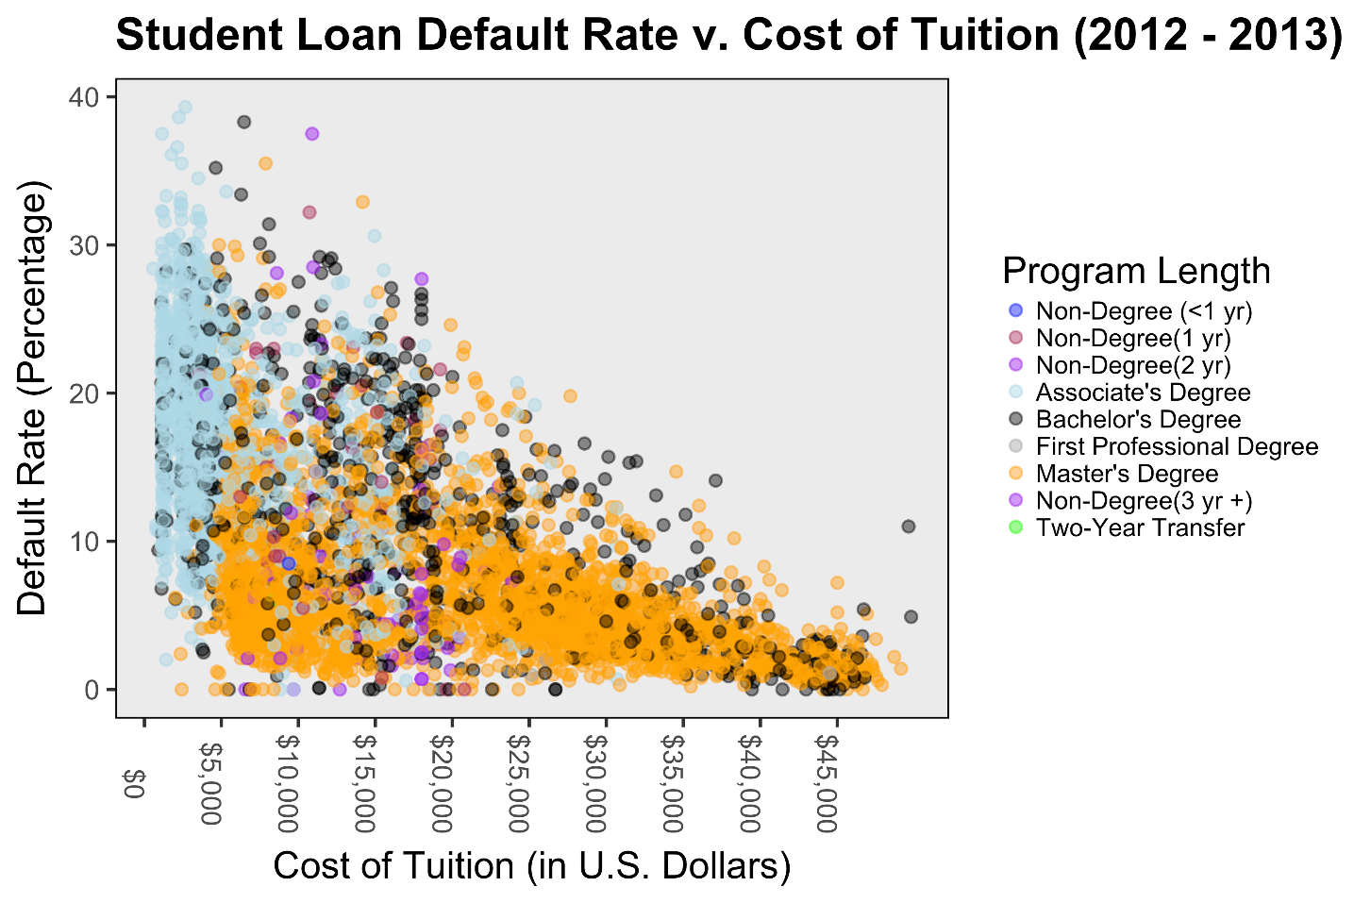
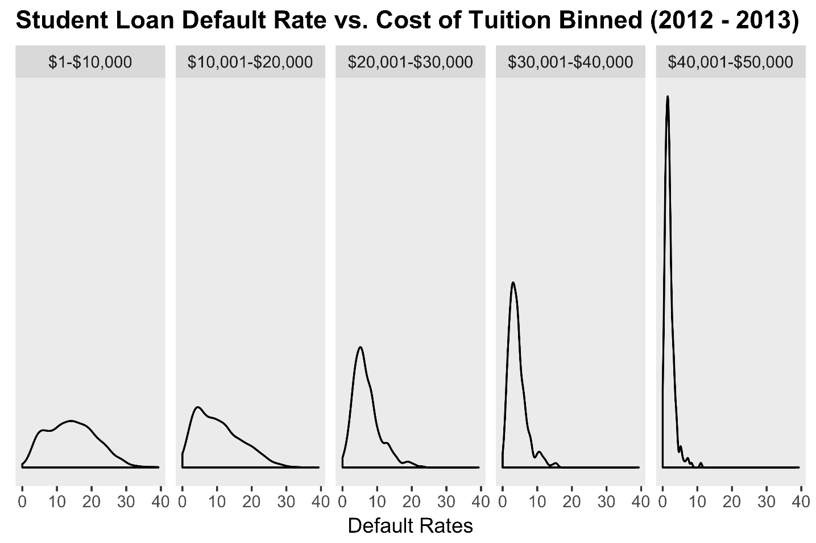
Analysis 1 <- Influence of cost of attendance on default rate
Default Rate on Cost of Tuition measured by Program Length
Default Rate by Cost of Tuition binned
Notes:
Cody

Slide 9
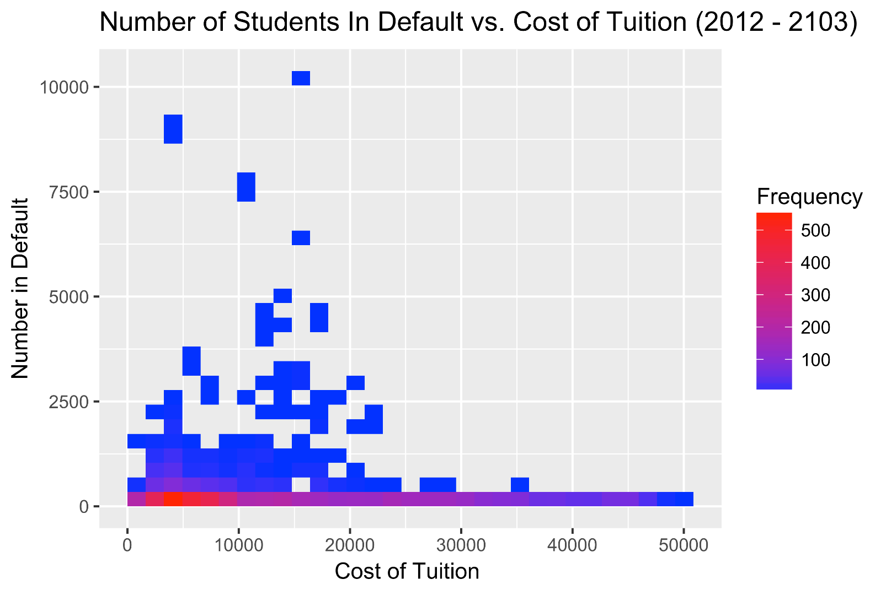
Analysis 1 <- Influence of cost of attendance on default rate
Density plot outlining number of students in default on cost of tuition
Notes:
Cody

Slide 10
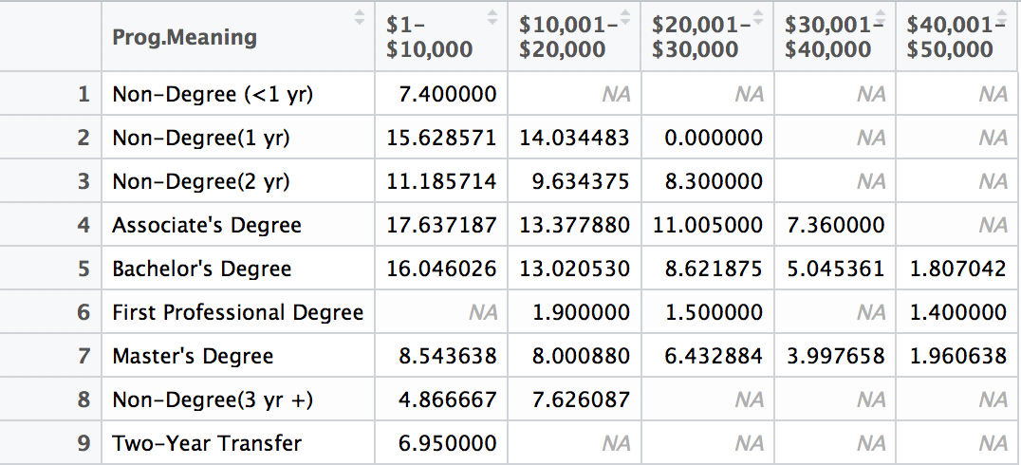
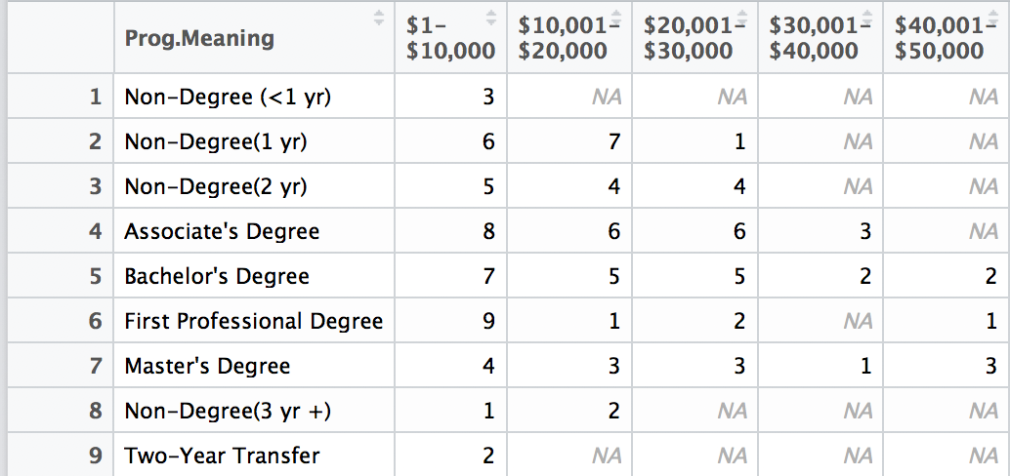
Analysis 1 <- Influence of cost of attendance on default rate
Default Rates Summary Tables
Notes:
Cody

Slide 11
Analysis 2: Default Rate by School Type
GOAL <- Summarize and plot default rates by the variable “School Type” for
years 2012 and 2013
CONSIDERATIONS <-
Change class and rename levels for variable “School Type”
Analyze average default rates by of complete dataset
Analyze based on DOE definitions of ‘good’ and ‘bad’
Develop plots that show if or how default rates are influenced by “School Type.”
CHALLENGES <-
Too few levels of “School Type”, provides incomplete picture
Data loss after merging files and purging incomplete cases
Notes:
Ben

Slide 12



Analysis 2: Default Rate by School Type
Average Default Rates by School Type
Percentage of institutions with a default rate <= 15%
Percentage of institutions with a default rate >= 30%
Notes:
Ben

Slide 13
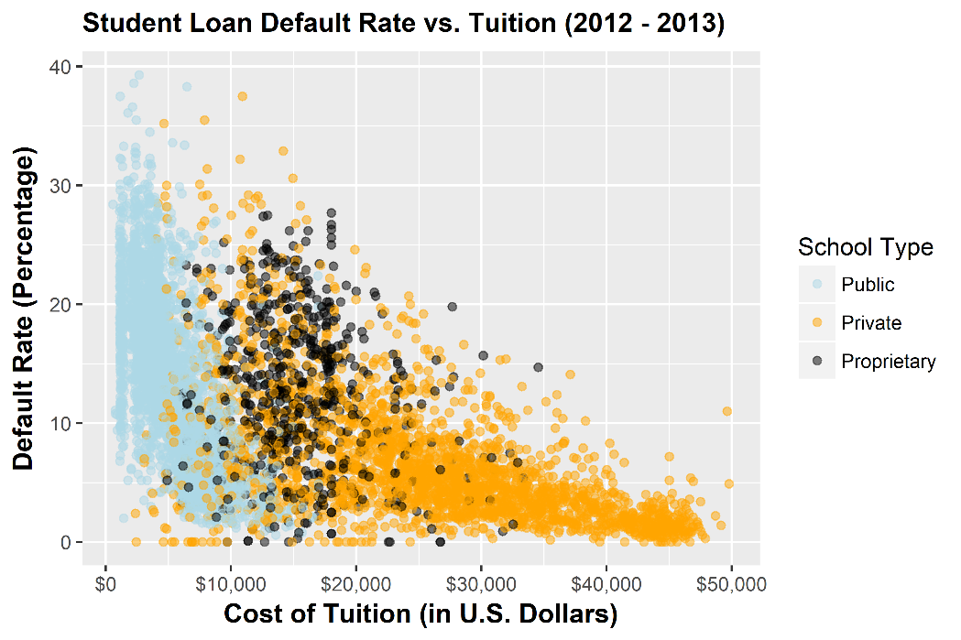
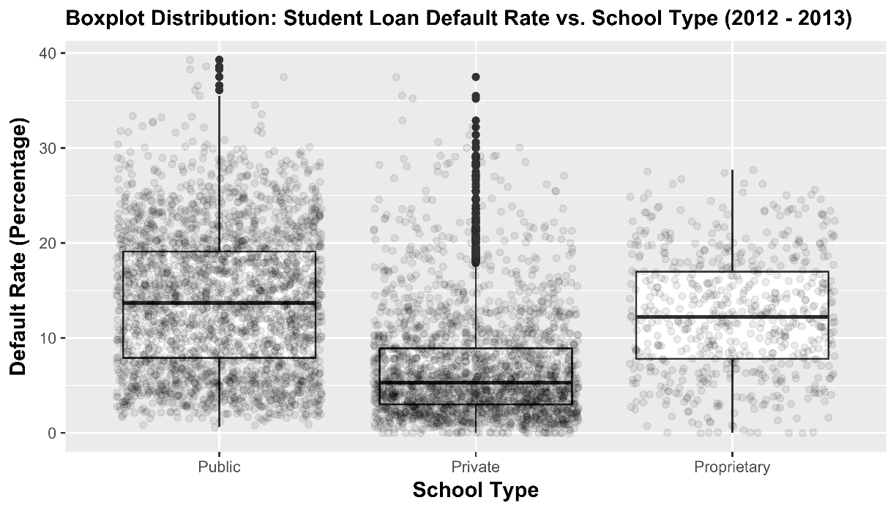
Analysis 2: Default Rate by School Type
Scatter Plot-Default Rate vs. Tuition
Observations identified by school type
Variables of default rate, tuition, school type appear to be correlated
Still doesn’t tell the ‘whole story.’
Box Plot-Default Rate vs. School Type
Shows population density of each school type
Provides distribution of default rate for each school type.
Notes:
Ben

Slide 14
Analysis 3: Default Rate by School Location
GOAL <- Plot (using longitude and latitude) default rates by location
for U.S., a given state, and year
CONSIDERATIONS <-
CohortDefault Rate - Range of default rates (0 – 39.3) skews results, removed results 0 – 5%
Year – Two years of data, reduce map to just one year of data
Longitude and Latitude – Retain only the contiguous 48 states data
State – Allow for ability to map just one state
Notes:
Kris

Slide 15
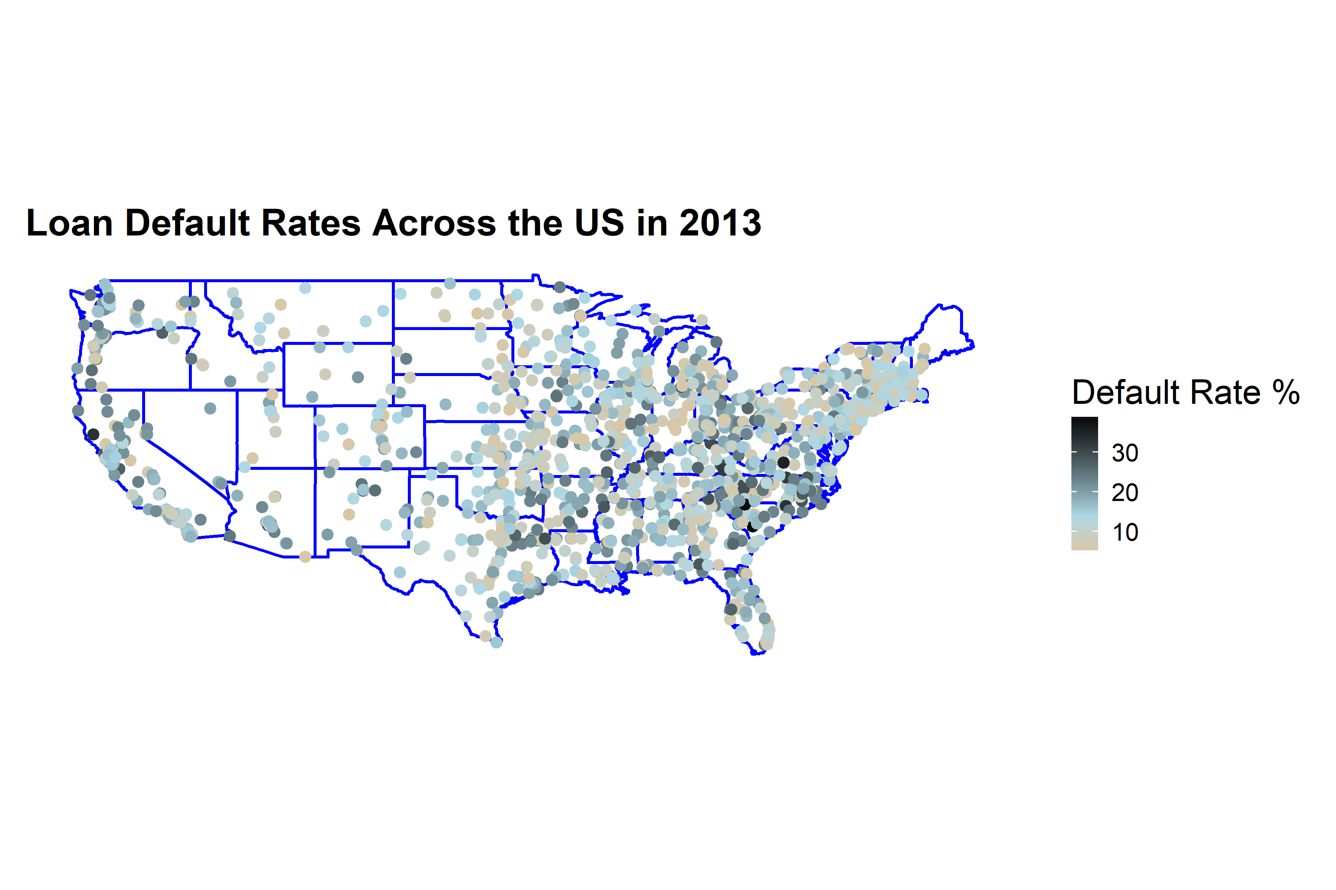
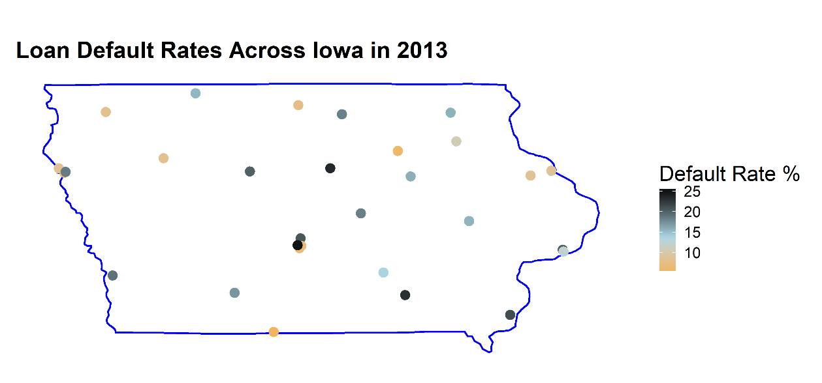
Analysis 3: Default Rate by School Location
Notes:
Kris

Slide 16
OVERVIEW OF THE ANALYSIS
<- Cost of tuition has a significant negative correlation with
loan default rates
<- Length of program has a significant negative correlation
with loan default rates
<- Public institutions have the highest default rates
<- Northeastern U.S. states have lower default rates
Notes:
Kris

